Slide 1







EFFECT OF SRM (STUDENT RELATIONSHIP MANAGEMENT) ON STUDENT SATISFACTION AT THAPAR
Presented by Tarandeep Singh
(102115038- 3NC2)
Humanities for engineers | 2024

Slide 2

TABLE OF CONTENTS
Introduction
Literature Review Objectives
Conceptual Framework
Statistical Model
Research Methodology
Data From Survey
Key Findings

Slide 3

INTRODUCTION
The project looks at how Student Relationship Management (SRM) practices at TIET affect student satisfaction. A questionnaire was shared with students using a QR code, and face-to-face meetings ensured good data collection. Analysis in IBM SPSS identified key SRM factors influencing student satisfaction at TIET.

Slide 4


WHY IS STUDENT SATISFACTION IMPORTANT
Student satisfaction in college is very important because it affects how well students do in their classes and their overall experience at school. Happy students are more likely to participate in their studies and join in on activities. High student satisfaction also boosts the college's reputation and can help attract new students. Satisfied students may become loyal alumni who support the college in future

Slide 5

LITERATURE REVIEW
Bueno(2023)
Student academic performance and success of the school were dependent upon the facilities provided by the graduate school.
Furqon et al (2023)
Lms and other smart technologies used in academic intuitions have a huge positive impact
Ming (2010)
conceptual framework where student’s choice of college was taken as a dependent variable and college characteristics along with the effort of the college to market itself to students made up independent factors

Slide 6
LITERATURE REVIEW
O Brien at al (2007)
the desire for self-improvement, the desire to increase personal opportunities in the job market are important variables
Bowden (2011)
Psychological factors and attachment to the brand of the university are important factors for determining the student loyalty.
Oluseye et al (2014)
Universities must manage their student lifecycle properly

Slide 7
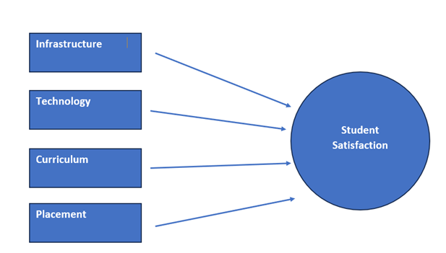
CONCEPTUAL FRAMEWORK
Independent Variables
Dependent Variable
Source- Complied By Author

Slide 8
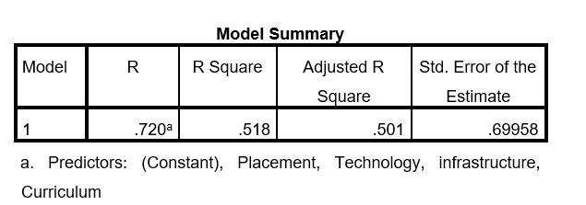
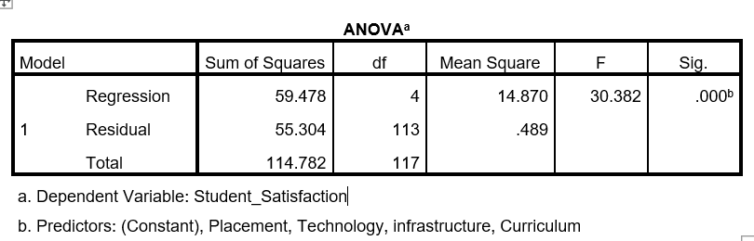
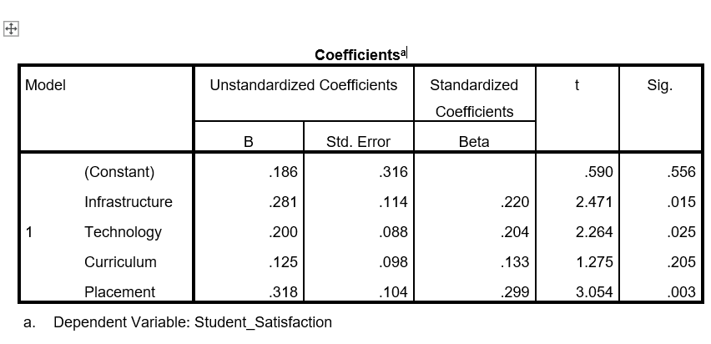
STATISTICAL MODEL

Slide 9
RESEARCH METHODOLOGY
The survey was filled by about 138 students, and after reviewing the forms, 118 were chosen for analysis. The questionnaire included questions on students' names, ages, and emails. It also asked about courses and years of study. Other questions covered topics like infrastructure, technology, curriculum, and placements, as well as measuring student satisfaction. Analysis was done using SPSS.

Slide 10
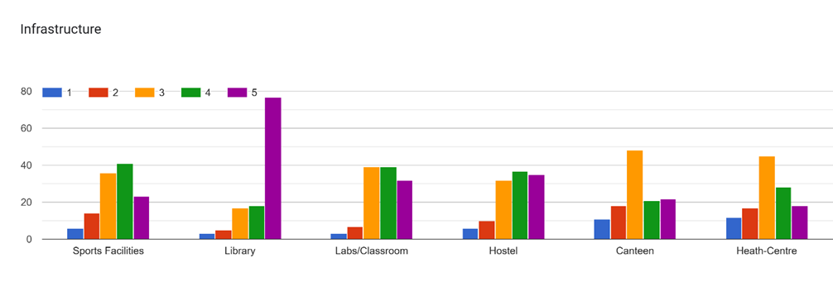
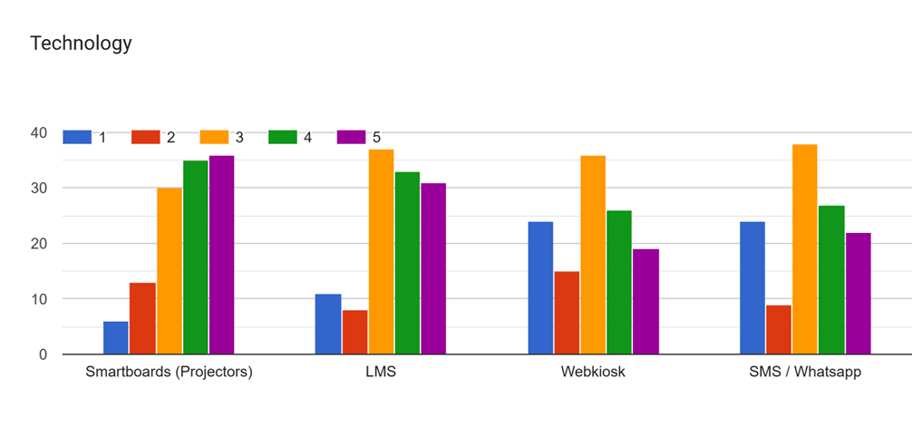
DATA OBTAINED VIA SURVEY (INDEPENDENT VARIABLES)
The below numbers are ratings for the given parameters out of 5 with 5 highest and 1 lowest

Slide 11
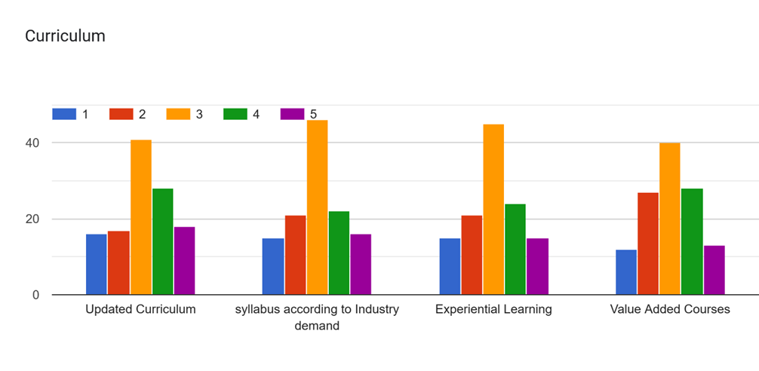
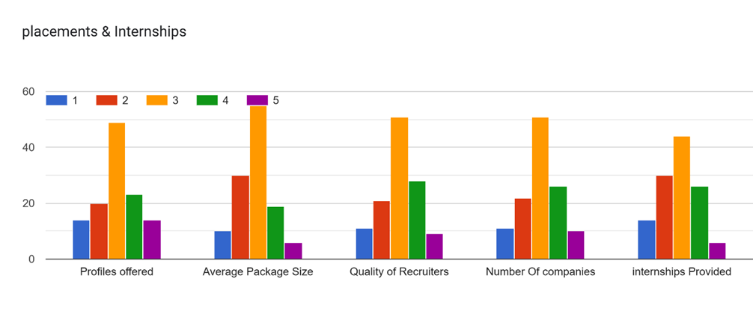
DATA OBTAINED VIA SURVEY (INDEPENDENT VARIABLES)
The below numbers are ratings for the given parameters out of 5 with 5 highest and 1 lowest

Slide 12
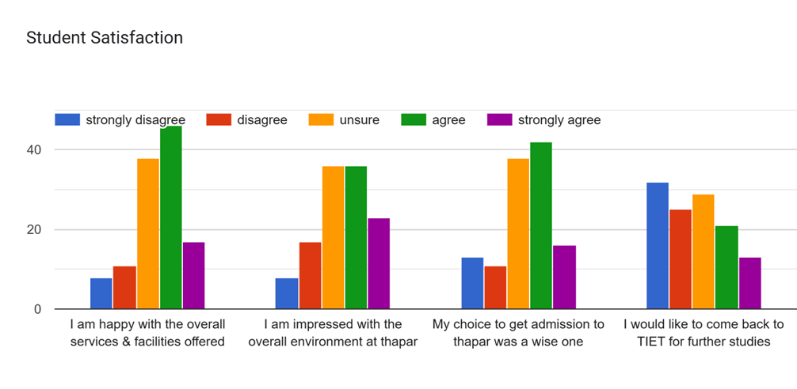
DATA OBTAINED VIA SURVEY (DEPENDENT VARIABLE)

Slide 13

KEY FINDINGS
The study found that Student Relationship Management (SRM) practices significantly affect student satisfaction at TIET. Factors such as infrastructure, technology, and placement opportunities had a major influence on satisfaction levels. However, evidence of curriculum’s role in student satisfaction was not found. About 50% of student satisfaction is explained by our factors.

Slide 14

Presented by Tarandeep Singh
TIET 2024

